Slide 1

GPU Shader 1
電腦圖學導論實習
Information Technology Innovation | NTUST

Slide 2
Overview
The OpenGL Pipeline
The OpenGL Pipeline with Shaders
Program、VBO、VAO
Texture
Shader
P4 Water Surface

Slide 3
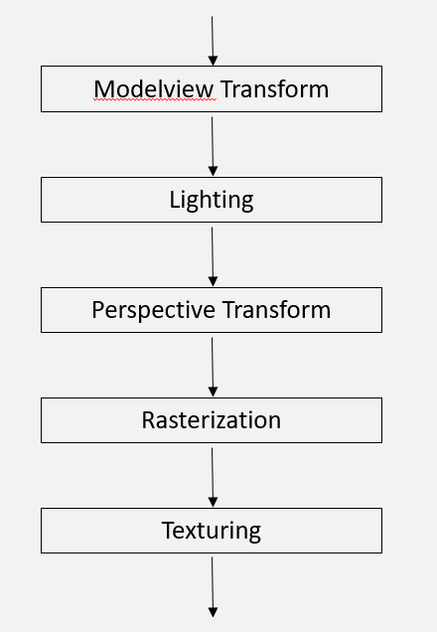
Recall Our Fixed Pipeline
You only set up some positions and colors then draw
glColor3f (1.0, 0.0f, 0.0f);
glBegin(GL_TRIANGLES);
glVertex3f(-1.0f, -0.5f, 1.0f); // A
glVertex3f( 1.0f, -0.5f, 1.0f); // B
glVertex3f( 0.0f, 0.5f, 1.0f); // C
glEnd();
CPU
X100 one by one

Slide 4
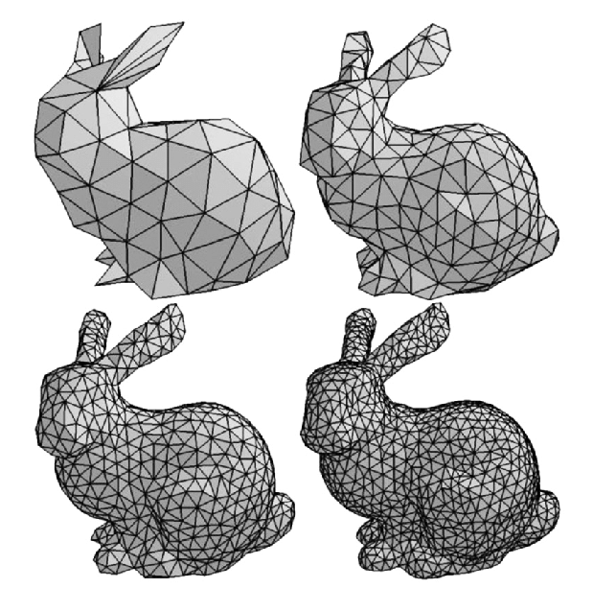
What’s wrong with fixed pipeline
You can’t customize what happened in the stage
These settings are setting up in sequence, when it comes to a mesh with above kilo vertices it will be extremely slow.
CPU method (1.x, 2.x)
glBegin(GL_TRIANGLES)
//many vertices and property(color, normal…)
glEnd()

Slide 5
Layout of the Detail in GPU Techniques
GPU(graphics processing unit)
The OpenGL Pipeline
Vertex and Fragment Shaders
https://www.youtube.com/watch?v=-P28LKWTzrI

Slide 6
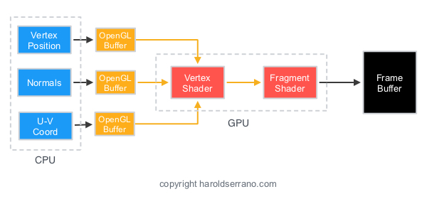
Recall Our Fixed Pipeline
You only set up some positions and colors then draw

Slide 7
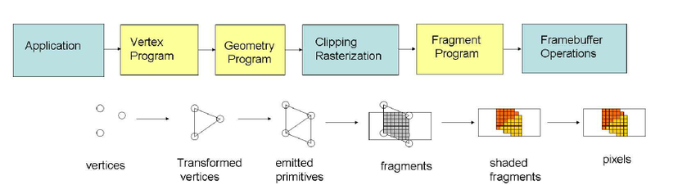
Vertices
CPU method (1.x, 2.x)
glBegin(GL_TRIANGLES)
//many vertices and property(color, normal…)
glEnd()
GPU method (3.x, 4.x)
glBindVertexArray(VAO); glDrawArrays(GL_TRIANGLES, …, …);
Programable and Parallelable

Slide 8
Simple Flow
VAO
Screen
Indicates how data stores in VBO
GPU
Vertices
VBO
Shaders
FrameBuffer

Slide 9
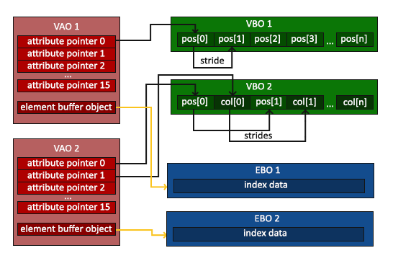
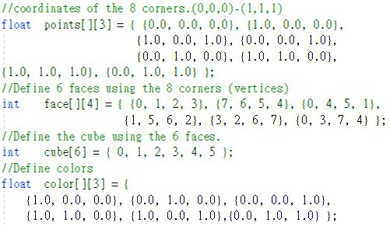
Vertices
Vertex Array Object
Have many VBOs and a EBO(or not).
Vertex Buffer Object
Element Array Buffer

Slide 10
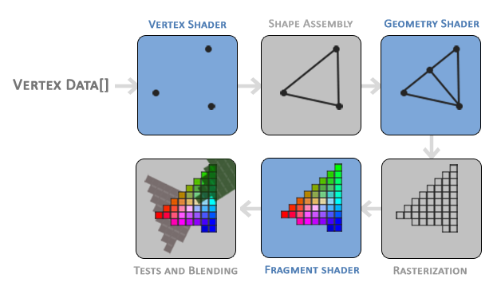
Pipeline
GLSL Shader (2.x, 3.x, 4.x)(Using GPU!)
Vertex Shader
Fragment Shader
…
glUseProgram(shaderProgram);
0 mean default shader

Slide 11
Examples (Vertex Shader)
How many times are the fragment and vertex shaders executed on this scene

Slide 12
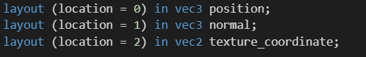
Examples (Vertex Shader)
Vertex shader runs once per vertex

Slide 13
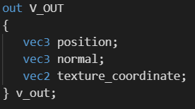
Examples (Fragment Shader)
Vertex shader runs once per vertex
Fragment shader runs once per pixel

Slide 14
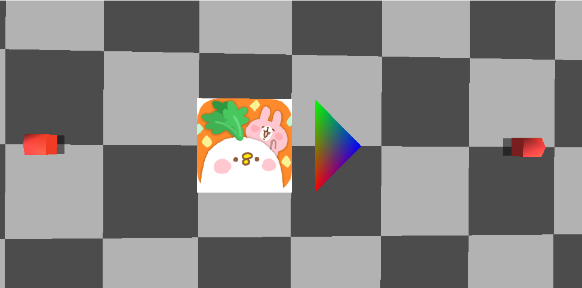
Shader Examples

Slide 15
Shader
https://learnopengl.com/Getting-started/Shaders
GLSL
Vertex shader
Fragment shader

Slide 16
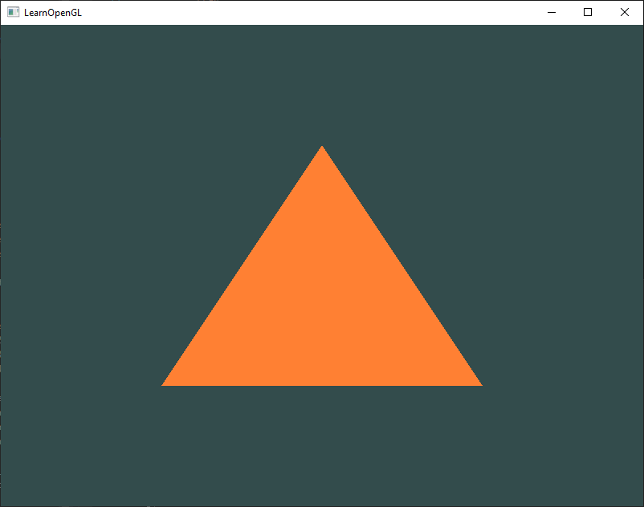
Hw08
Draw a triangle with shaders
https://learnopengl.com/Getting-started/Hello-Triangle

